Slide 1

SPACE X IBM DATA SCIENCE CAPSTONE PROJECT
Diego Ignacio Ortiz

Slide 2
CONTENT OUTLINE
EXECUTIVE SUMMARY
INTRODUCTION
METHODOLOGY
RESULTS
CONCLUSION

Slide 3
EXECUTIVE SUMMARY
METHODOLOGIES
Data Collection with RestAPI and Web Scraping
EDA with Data Visualization
EDA with SQL
Interactive Maps with Folium
Interactive Dashboards with Plotly Dash
Predictive Analysis (Classification)
• RESULTS
Exploratory Data Analysis (EDA)
Interactive Analytics
Predictive Analytics

Slide 4
Problems you want to find answers What are the key features of a successful or unsuccessful landing for Falcon 9's first stage? How do different rocket variables impact the success or failure of the landing? What conditions can SpaceX implement to achieve the highest landing success rate?
INTRODUCTION
Project background and context
This project aims to predict the success of Falcon 9's first stage landing. SpaceX can reuse the first stage, reducing launch costs to 62 million dollars compared to other providers who charge upward of 165 million dollars per launch. By predicting landing success, we can determine launch cost and provide valuable information for competitors.

Slide 5

METHODOLOGY
01

Slide 6
METHODOLOGY -EXECUTIVE SUMMARY
Data Collection
SpaceX REST API
Web Scraping from Wikipedia
Data Wrangling
Sampling Data
Dealing with Missing Values
One Hot Encoding for classification models
Perform exploratory data analysis (EDA) using visualization and SQL
Perform interactive visual analytics using Folium and Plotly Dash
Perform predictive analysis using classification models

Slide 7
DATA COLLECTION
To Collect the data into Datasets we use the SpaceX Rest API
We obain data such as rocket used, payload delivered, launch speecifications, landing specifications and landung outcome.
The Space X Rest API Endpoint URL is api.spacexdata.com/v4/
SpaceX Rest API call
API returns JSON file
Make Dataframe from JSON
Clean & Export Data
dataset_part1.csv

Slide 8
DATA COLLECTION
We can also use Web Scraping from Wikipedia
We use the url :
https://en.wikipedia.org/w/index.php?title=List_of_Falcon_9_and_Falcon_Heavy_launches&oldid=1027686922
Get HTML response from Wikipedia
Extract data
with
BeautifulSoup
Make Dataframe
Export Data
spacex_web_ scraped.csv

Slide 9
METHODOLOGY -EXECUTIVE SUMMARY
Data Collection
SpaceX REST API
Web Scraping from Wikipedia
Data Wrangling
Sampling Data
Dealing with Missing Values
One Hot Encoding for classification models
Perform exploratory data analysis (EDA) using visualization and SQL
Perform interactive visual analytics using Folium and Plotly Dash
Perform predictive analysis using classification models

Slide 10
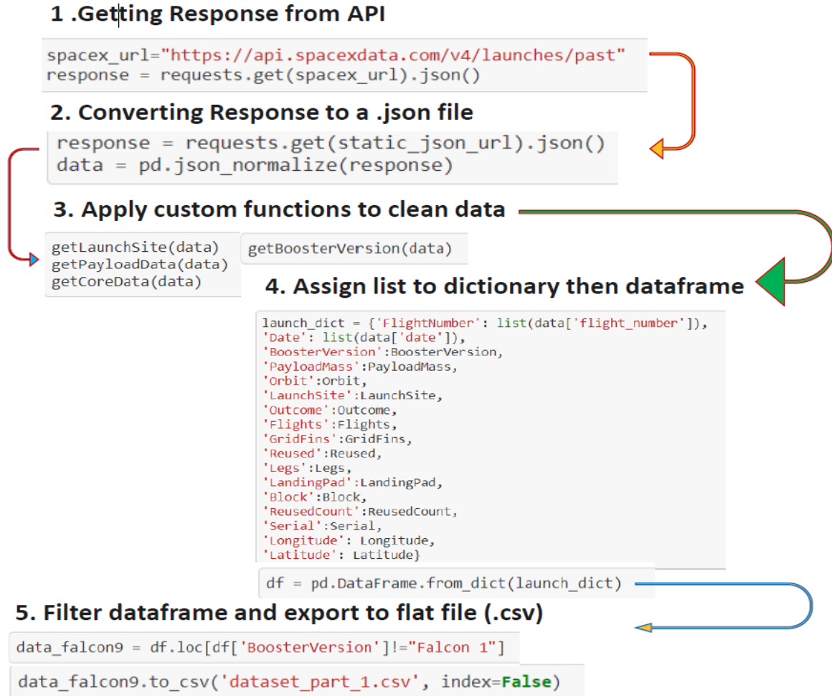
DATA COLLECTION
Data collection with SpaceX REST API calls

Slide 11
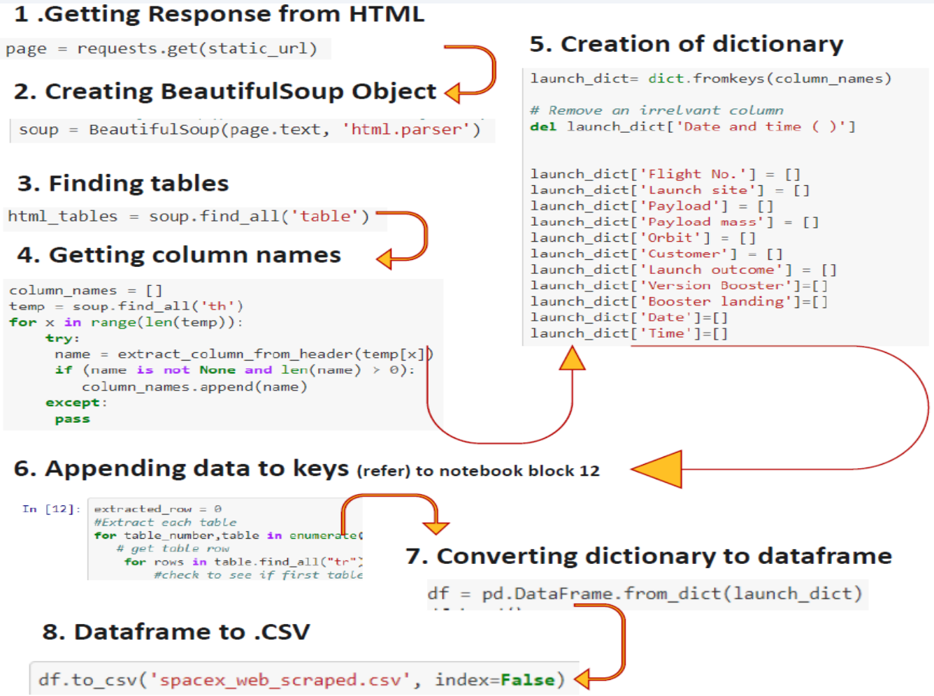
DATA COLLECTION
Web Scrapping from Wikipedia

Slide 12
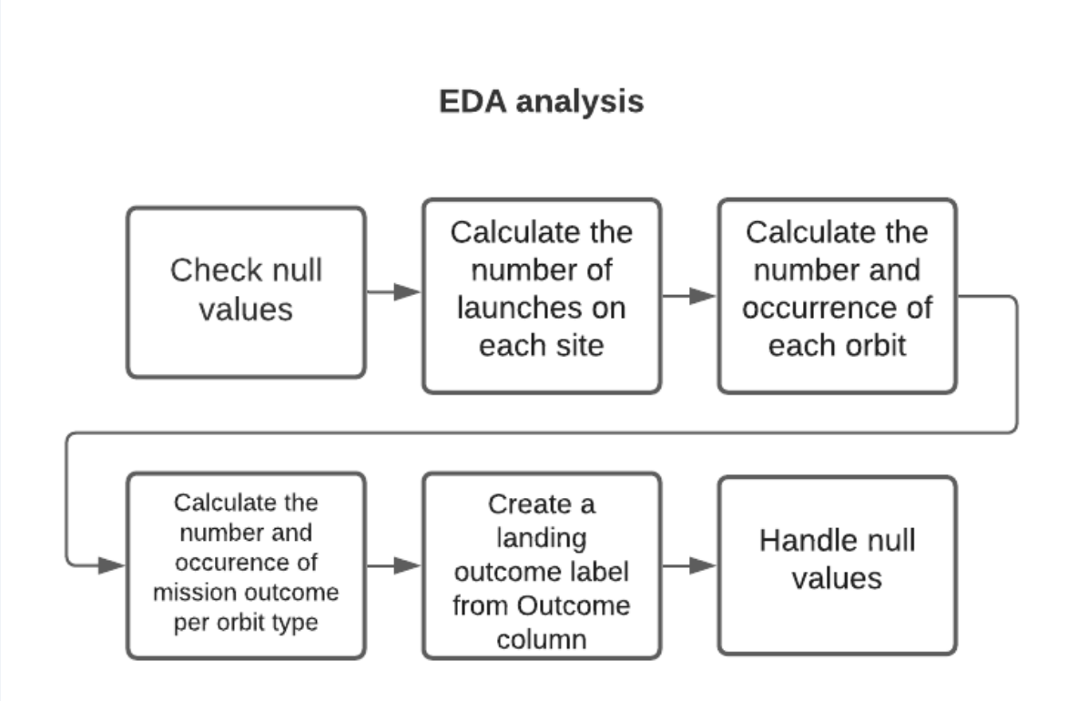
DATA WRANGLING

Slide 13
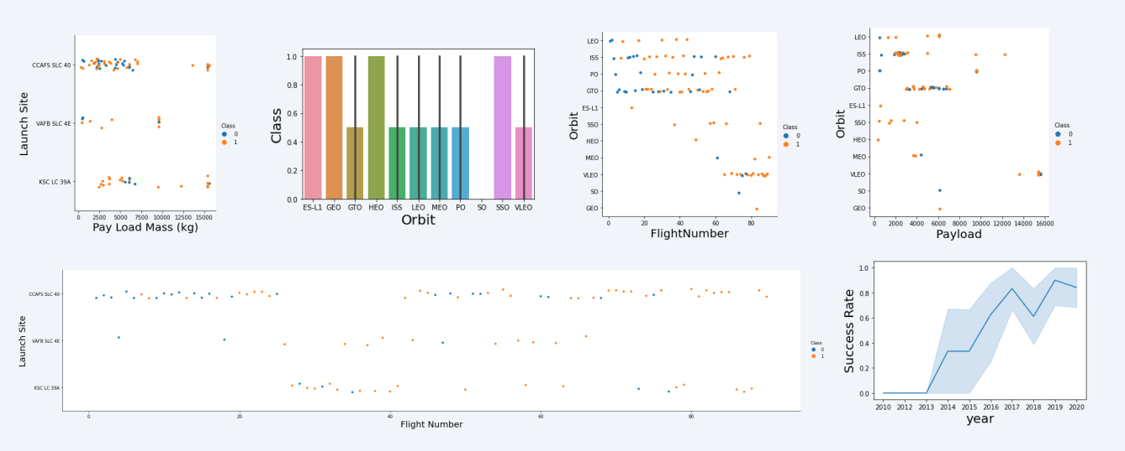
EDA DATA VISUALIZATION

Slide 14
EDA WITH SQL
SQL queries performed include:
Displaying the names of the unique launch sites in the space mission
Displaying 5 records where launch sites begin with the string 'KSC’
Displaying the total payload mass carried by boosters launched by NASA (CRS)
Displaying average payload mass carried by booster version F9 v1.1
Listing the date where the successful landing outcome in drone ship was achieved.
Listing the names of the boosters which have success in ground pad and have payload mass greater than 4000 but less than 6000.
Listing the total number of successful and failure mission outcomes
Listing the names of the booster_versions which have carried the maximum payload mass.
Listing the records which will display the month names, successful landing_outcomes in ground pad ,booster versions, launch_site for the months in year 2017
Ranking the count of successful landing_outcomes between the date 2010 06 04 and 2017 03 20 in descendingorder.

Slide 15
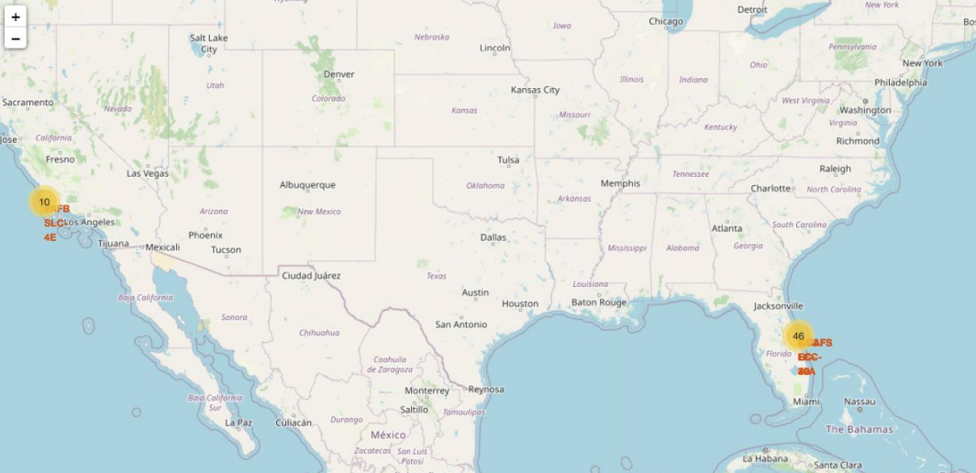
INTERACTVIE MAP WITH FOLIUM

Slide 16
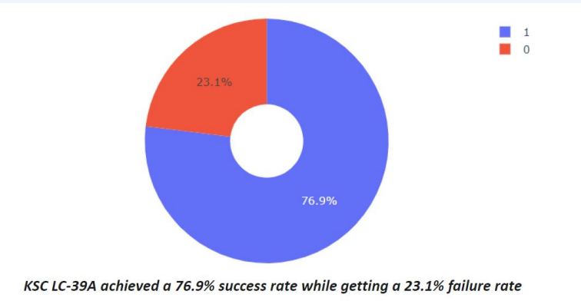
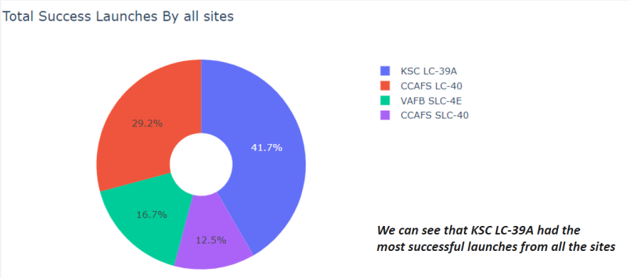
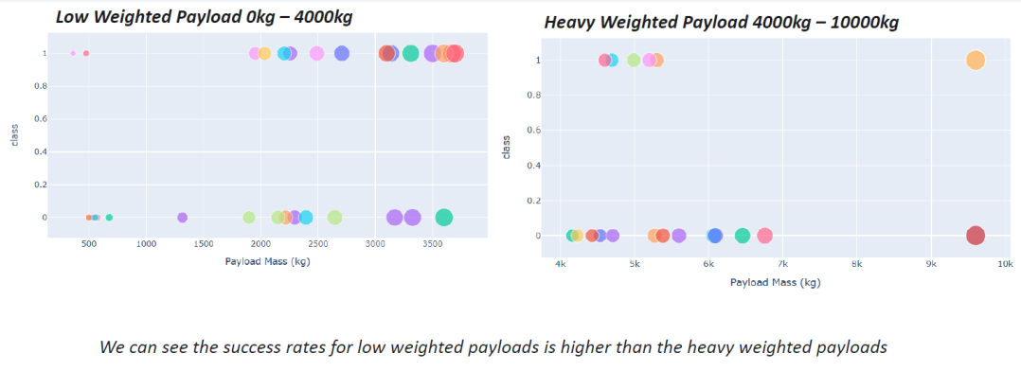
DASHBOARD WITH PLOTLY DASH

Slide 17
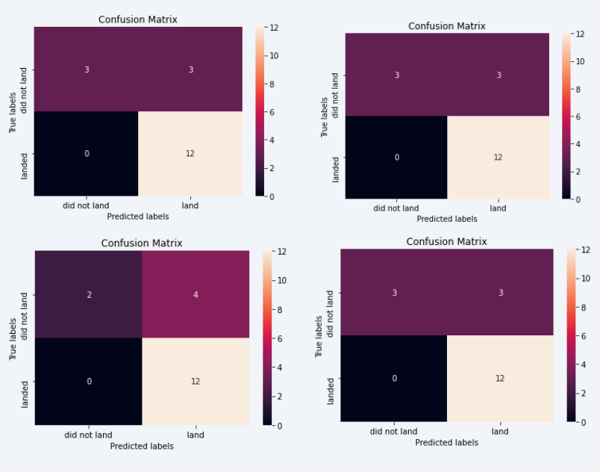
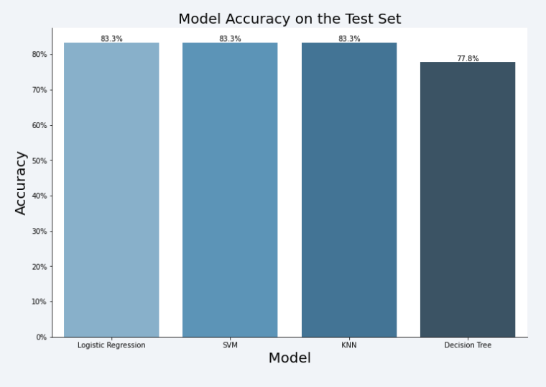
PREDICTIVE ANALYSIS
The SVM, KNN, and Logistic Regression model achieved the highest accuracy at 83.3%, while the SVM performs the best in terms of Area Under the Curve at 0.958.

Slide 18
RESULTS
The SVM, KNN, and Logistic Regression models are the best in terms of prediction accuracy for this dataset.
Low weighted payloads perform better than the heavier payloads.
The success rates for SpaceX launches is directly proportional time in years they will eventually perfect the launches.
KSC LC 39A had the most successful launches from all the sites.
Orbit GEO,HEO,SSO,ES L1 has the best Success Rate.

Slide 19
CONCLUSIONS
The SVM, KNN, and Logistic Regression models are the best in terms of prediction accuracy for this dataset.
Low weighted payloads perform better than the heavier payloads.
The success rates for SpaceX launches is directly proportional time in years they will eventually perfect the launches.
KSC LC 39A had the most successful launches from all the sites.
Orbit GEO,HEO,SSO,ES L1 has the best Success Rate

Slide 20
THANKS

